Slide 1
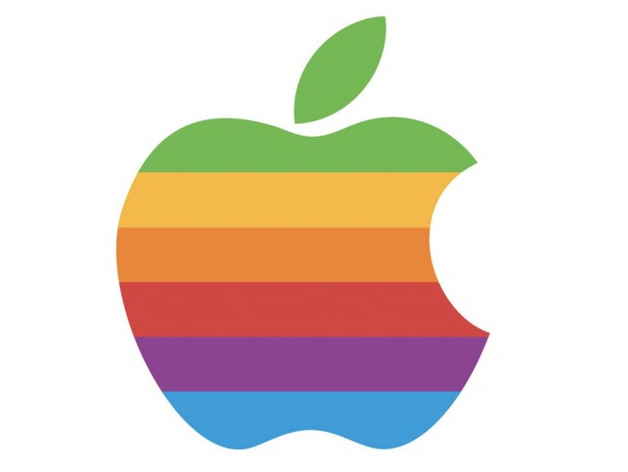
Is the Internet broken?
And if so: how to fix it
(And who‘s job is that, anyway?)
Tim Cole
Author of Wild Wild Web
What the history of the Wild West teaches us about the future of the Digital Society

Slide 2
Lesson 1
(1863-1952)

Slide 3
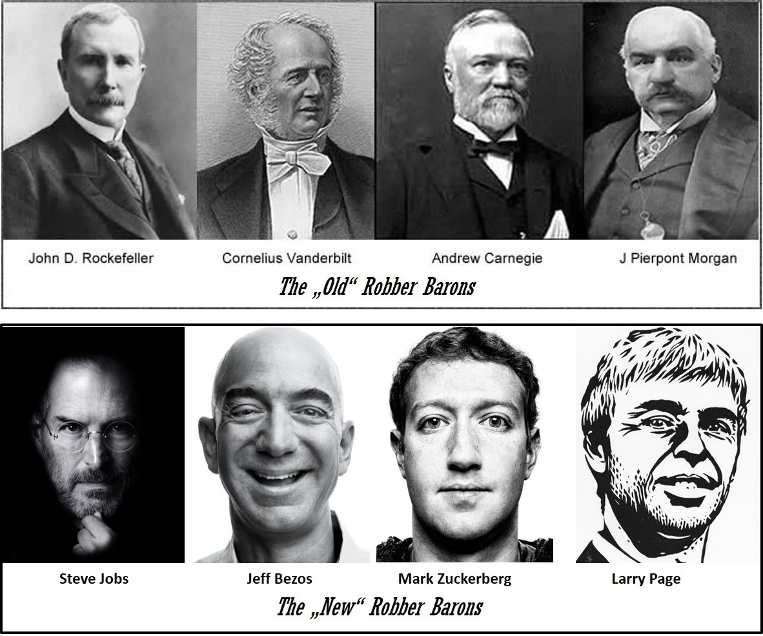

Slide 4
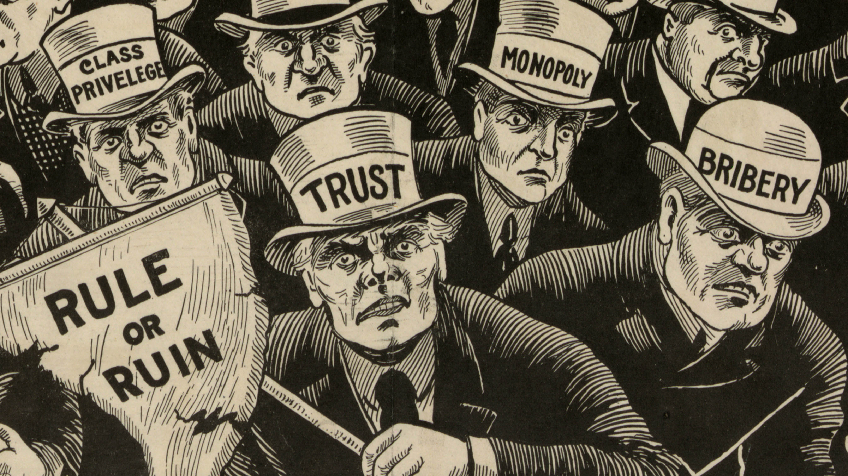

Slide 6
Lesson 2

Slide 8
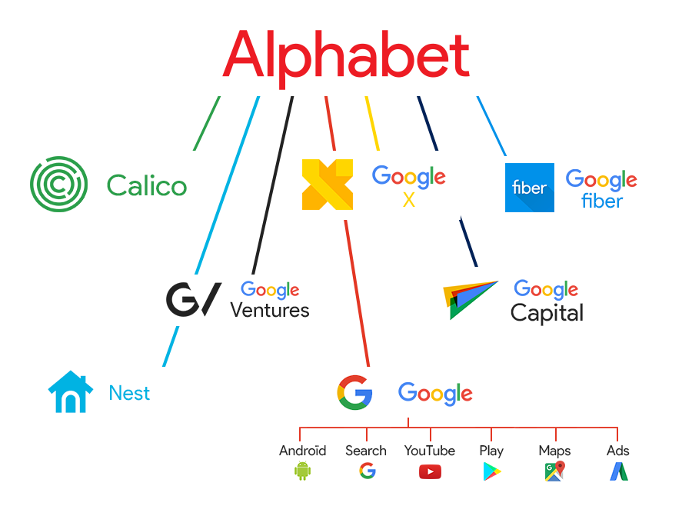

Slide 9
Lesson 3
No one is too big to fail!

Slide 10
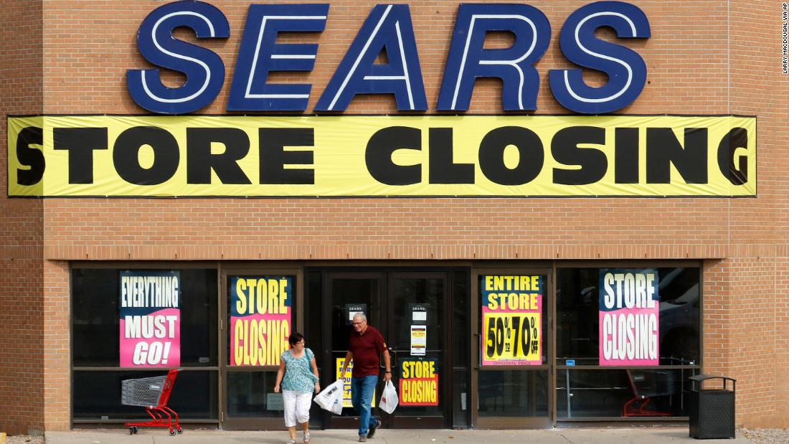

Slide 12
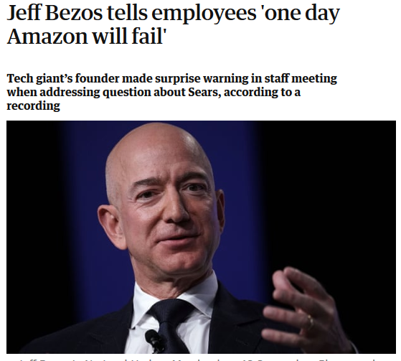

Slide 13
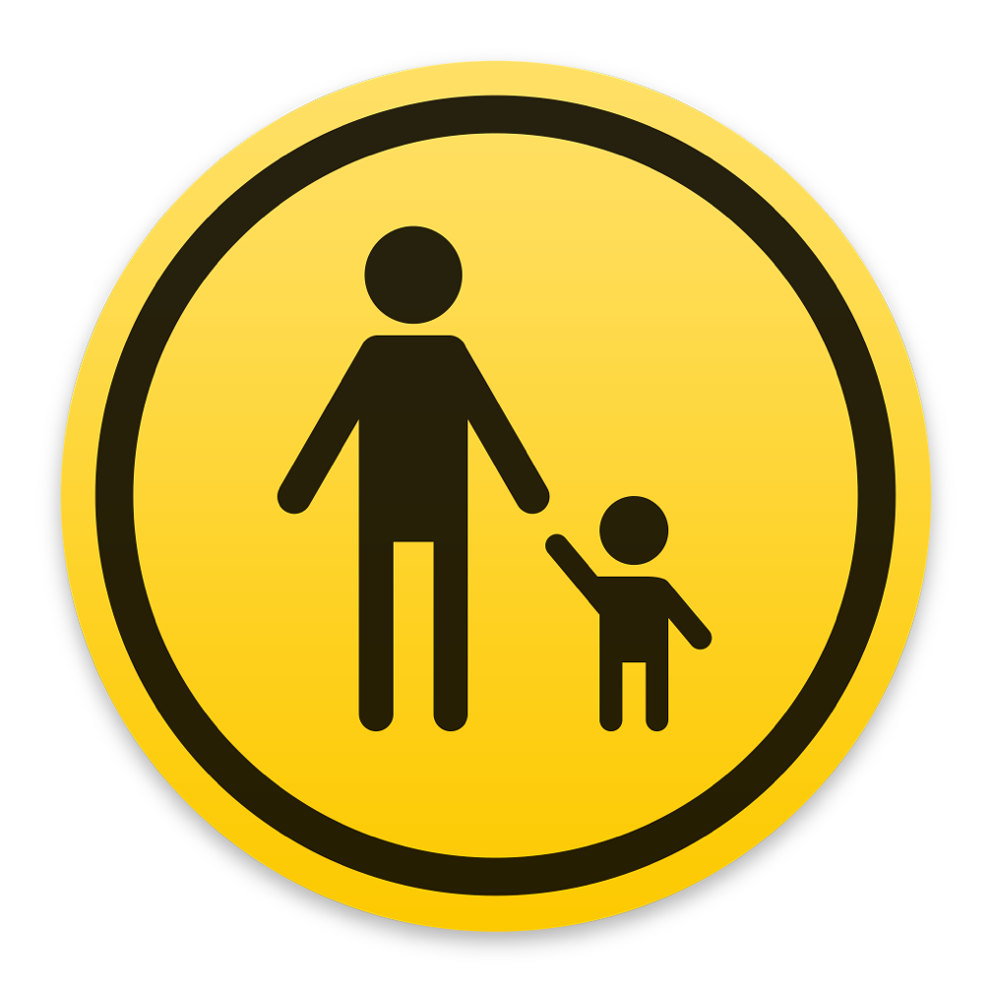
Lesson 5: Tech need adult supervision!

Slide 16
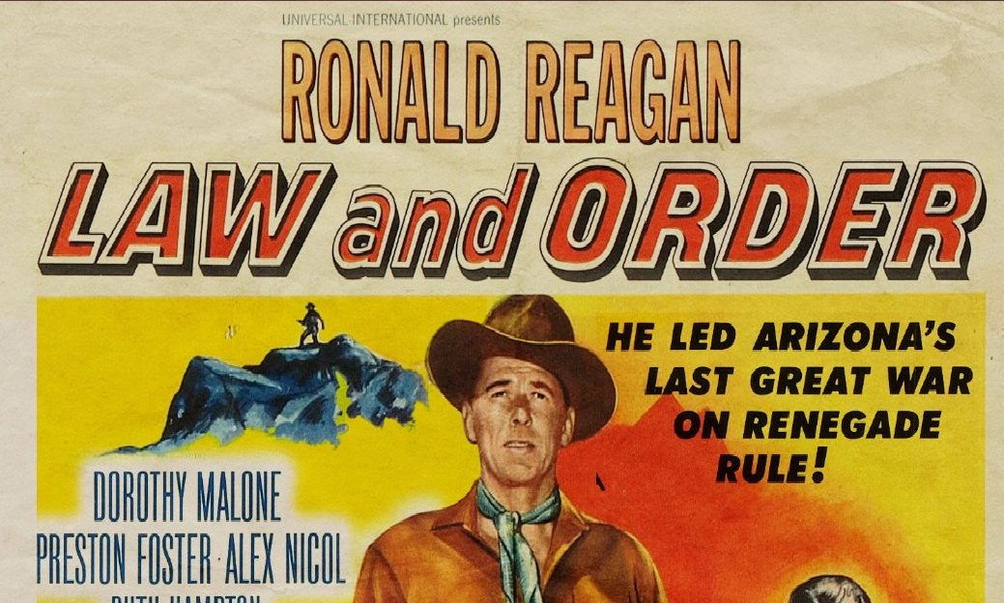
Lesson 6: We need new rules!

Slide 17
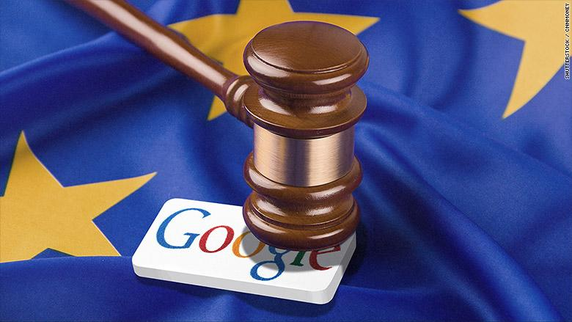
So who‘s job is it?

Slide 18
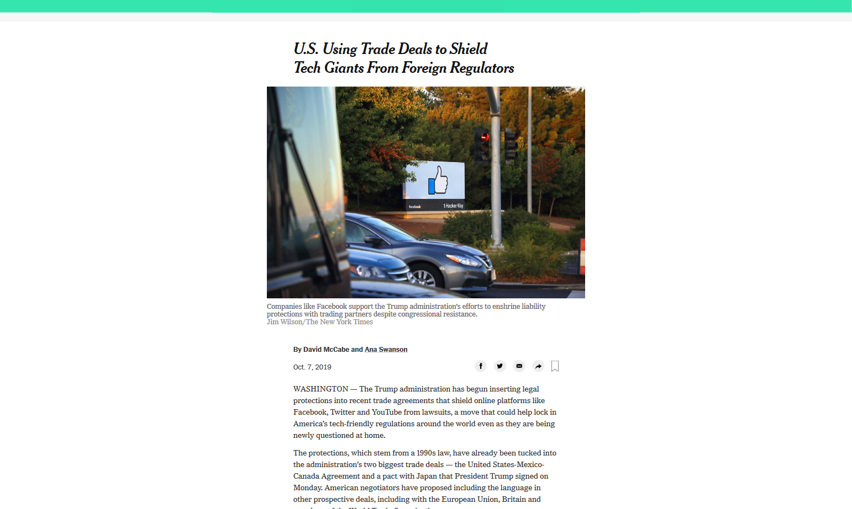

Slide 19
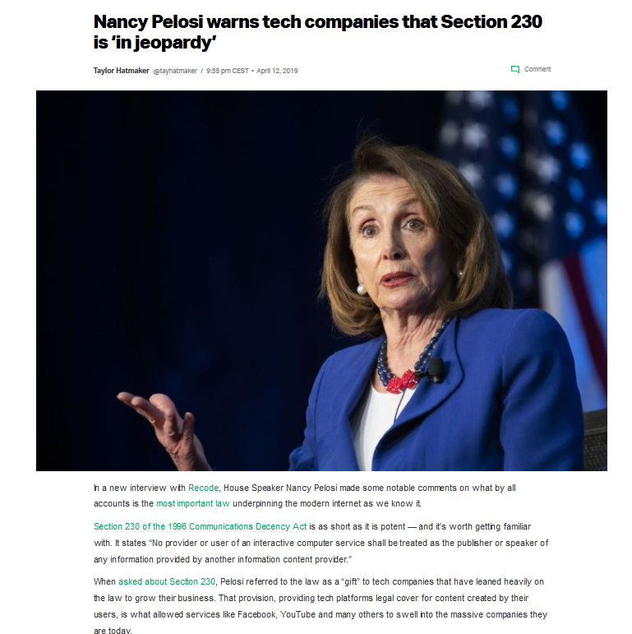

Slide 20
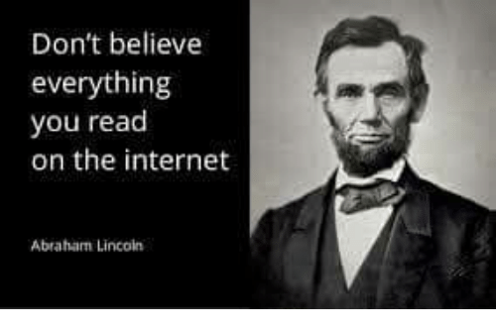
Personal responsibility

Slide 21
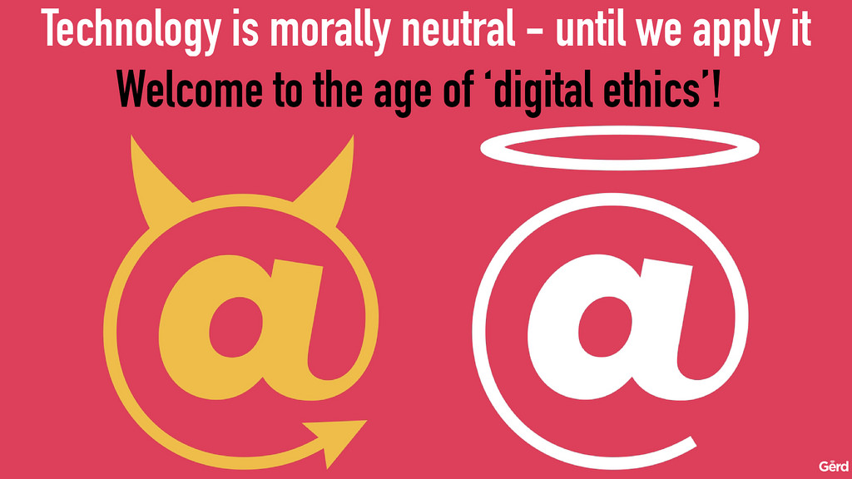
Lesson 7

Slide 22
Lesson 9
Technology has no ethics, but society depends upon it!

Slide 26
Ethics Officer

Slide 27
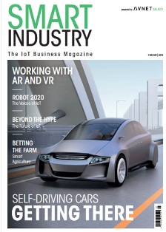
Machines need ethics, too!

Slide 28
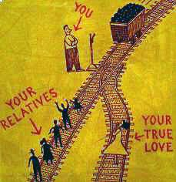
Machines need ethics, too!
The „Trolley Problem“

Slide 29
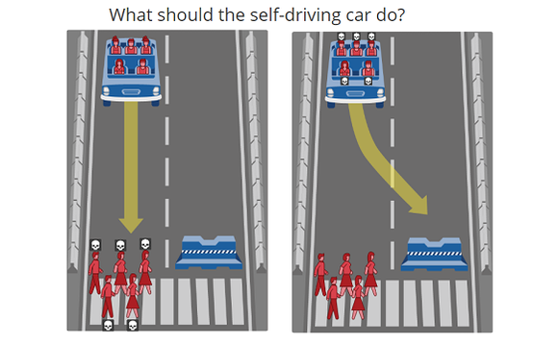

Slide 30
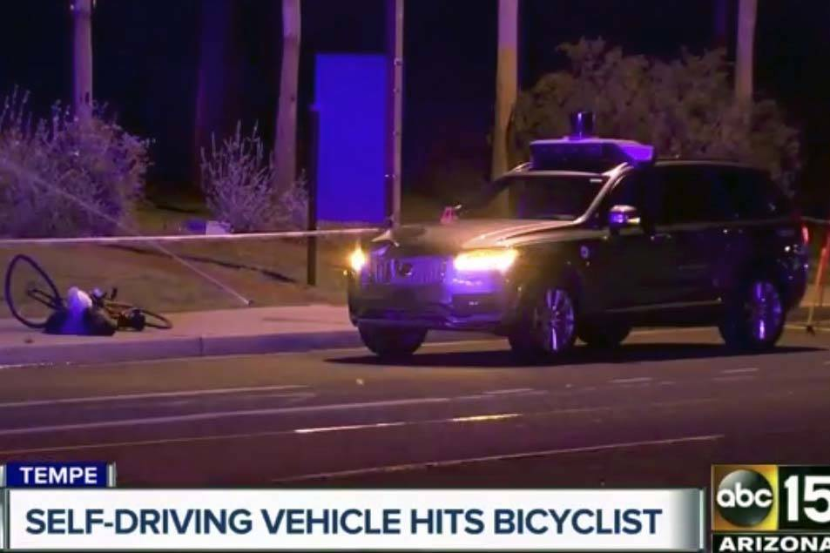

Slide 31
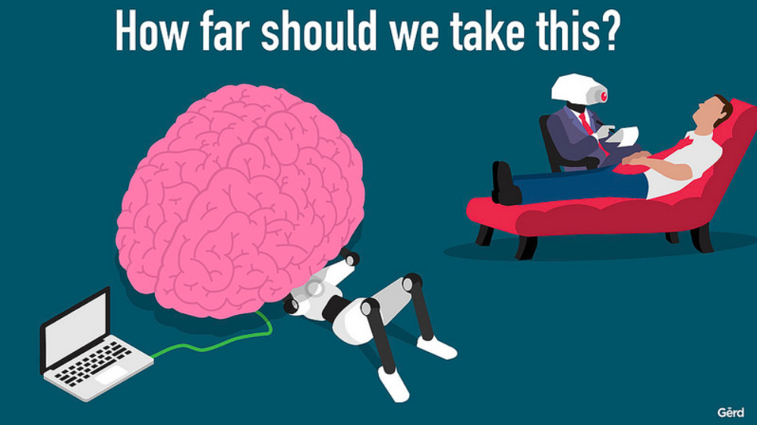

Slide 34
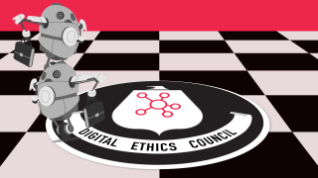

Slide 36
The biggest question of all:
Are you ready?

Slide 37
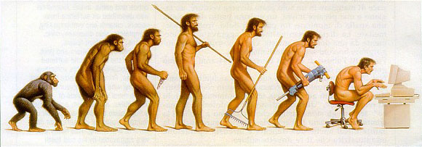
Lesson 10: You can‘t stop change from happening
…but you can slow it down (for a while)

Slide 38
Notes:
As the famous American civil rights activist Eldridge Cleaver, the author of Soul on Ice, once said: „If you‘r not part of the solution, you must be part of the problem.“ I sincerely hope nobody in this room wants to be part of the problem, so please, be part of the solution!

